Slide 1



Enhancing Efficiency and Sustainability in Specialty Chemicals and Petrochemical Plants: Role of Advanced Alloys in Maximizing Uptime in Corrosive Environments
DOCUMENT TITLE
2023-2024
NAME OF THE BU
DATE
Shabareesh Nair
Director Technical Marketing
Process Industry Solutions Manager
Asia & Middleeast

Slide 2
INDEX
TUBACEX GROUP INTRODUCTION
CORROSION & MATERIAL SELECTION
TUBACEX ALLOY PORTFOLIO/HEAT EXCHANGER PORTFOLIO
TUBACEX TUBES & PIPES PVT. LTD.
ADVANCED ALLOY SOLUTIONS FOR NEXT-GENERATION PETROCHEMICAL & SPECIALTY CHEMICAL APPLICATIONS
CONCLUSION

Slide 3
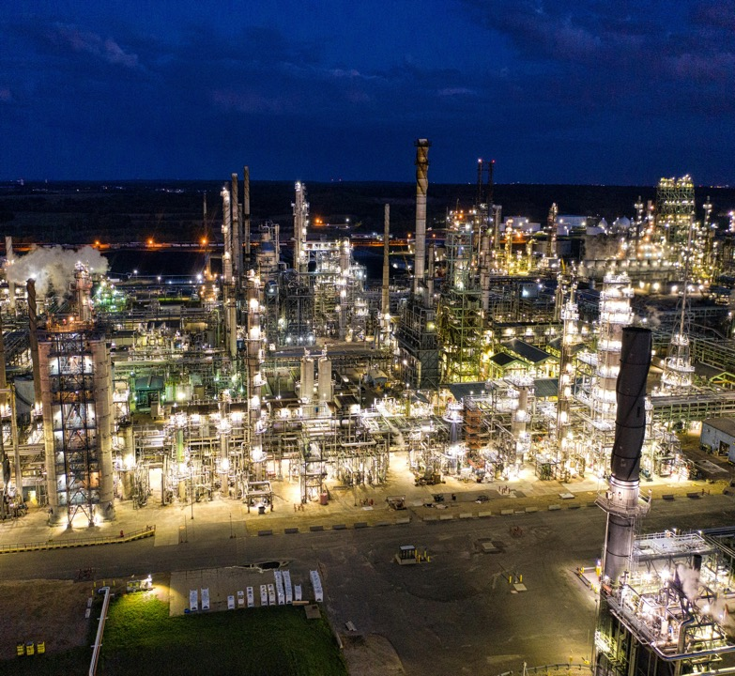
TUBACEX GROUP INTRODUCTION
Corporate Video
https://youtu.be/LIFaNRgtXxA?si=oa1Dy-ZUQha1wuv0

Slide 4
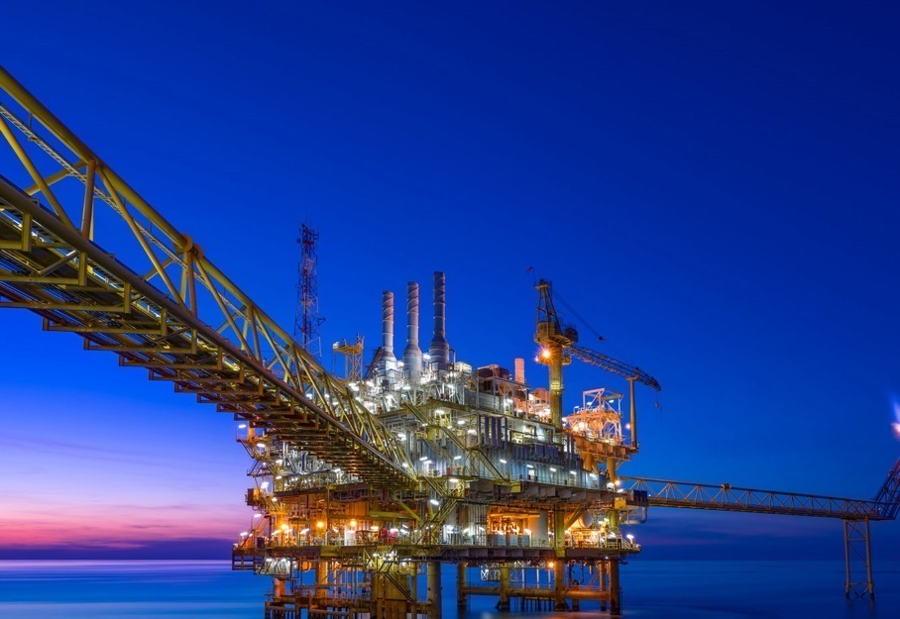
We operate where reliability is critical
WE ARE A WORLD LEADER IN ADVANCED INDUSTRIAL SOLUTIONS
FOR ENERGY AND MOBILITY
Demanding environments: high/low temperature, high pressure and high corrosion
FROM TUBULAR TO ADVANCED INDUSTRIAL SOLUTIONS
We are a global benchmark in the design, manufacturing, and installation of advanced industrial products and high-value-added services where only the most sophisticated solutions deliver the best performance
PREFERRED GLOBAL PARTNER
Clients are our asset. We meet their needs, transcend national boundaries and foster collaboration on a global scale with our fully integrated production model, covering the entire life cycle of the products. We take pride in co-creating innovative solutions alongside our customers
PIONEERING DIVERSIFICATION ACROSS MULTIPLE BUSINESS SECTORS
From the oil & gas sector to the low-carbon industry. As part of our commitment to high technological value products, we have developed production capabilities in those segments requiring higher levels of expertise where significant growth is expected

Slide 5

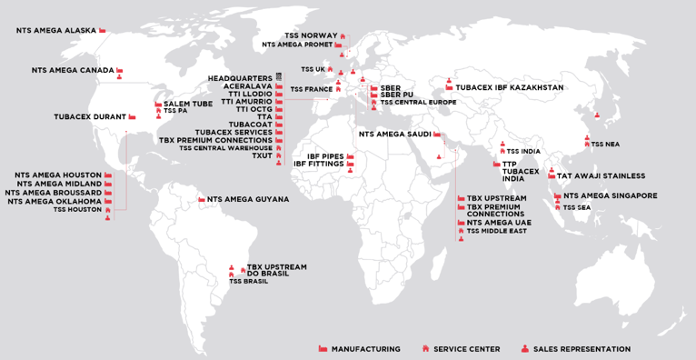
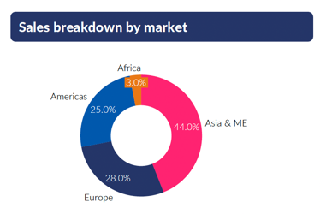
A GLOBAL LEADER IN ADVANCED INDUSTRIAL PRODUCTS AND SERVICES FOR ENERGY AND MOBILITY
2766
25
17
2
EMPLOYEES
PRODUCTION
PLANTS
SERVICE CENTERS
INNOVATION CENTERS
GLOBAL PRESENCE AND THREE MAIN HUBS
60
15
400
COUNTRIES SUPPLIED
COMMERCIAL OFFICES
QUALITY CERTIFICATIONS
2025 Sales € 720 million

Slide 6
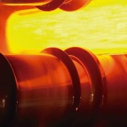
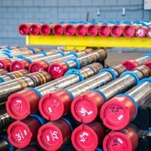
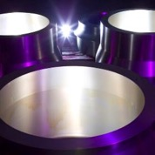
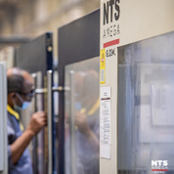
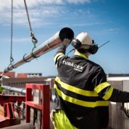
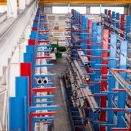
WITH A ROBUST PORTFOLIO
LOOKING AHEAD BY REACHING LONG-TERM AGREEMENTS WITH KEY CUSTOMERS
01
02
03
04
05
06
Stainless steel & high nickel alloys bars and billets
Seamless Stainless- Steel Pipes & Tubes
Forged fittings and special connections
High precision machining
Value added operation & services
Stock, Service & Trading
Fully integrated from steelmaking to high-performance tubular solutions and beyond
Notes:
The Group has the widest portfolio of tubular solutions. We produce and sell seamless stainless steel and high nickel alloy tubes used in countless applications.. Our seamless stainless steel tubes are specially designed to be used in industrial processes where high temperature, pressure and corrosion conditions take place.
In addition to its manufacturing capabilities, TUBACEX brings a different value proposition to the market and offers a series of high added value operations and services to complete its global offer.
We seek customer satisfaction through a portfolio of products and services that are constantly being developed.

Slide 7






SERVICES, PRODUCTS, PROCESSES AND GRADES
SERVICES/PRODUCTS
PROCESS
GRADES
MILLS
Pipes & Tubes
Extrusion/Cold Pilgered/Cold Drawning/Trepanning/ Flowforming
Austenitic Grades
Duplex/Superduplex
High Nickel Alloys
Seamless stainless from 1/8” to 72” OD
Coiled tubing up to 2”OD
Fittings/Special Components
Hot and Cold Bending
Austenitic Grades
Duplex/Superduplex
High Nickel Alloys
Y
Seamless and welded from ½” to 72”
Special components
Spools
Precision Machined Components
CNC Turning and Milling / Axis / Additive Manufacturing
Austenitic /Duplex/Superduplex/High Nickel Alloys / Tool Steels / Ti & Al Alloys
Repair and manufacturing
Special Subsea and Drilling components
Bar and billets
Rolled and Forged
Austenitic Grades
Duplex/Superduplex
High Nickel Alloys
Ferritic-Martensitic
Round: from 165 to 600 mm
Square: from 120 to 700mm
Rectangular and flat bar: up to 600mm
Ingot up to 20tons
Services
Package Compiler
Trading
Fabrication
Austenitic Grades
Duplex/Superduplex
High Nickel Alloys
8 Strategically located Serv. Centers
Stock of 65M€ of Seamless Stainless Pipes and Tubes
Special Added value activities
Ceramic Coatings
Notes:
9 Business Units

Slide 8









RESEARCH & DEVELOPMENT
UREMIUM 29
ALLOY 699 XA
Uremium 29 is a super-duplex material specifically developed for Urea service by Casale and Tubacex, a global leader of S.S. and high Ni-alloys tubular solution.
Metal-dusting resistance material 699XA in collaboration with VDM, for Syngas, Ammonia & other applications.
ADVANCED COATING TECHNOLOGY
SATURN 31
SATURN 31 development in collaboration with Saipem for High Pressure Urea Synthesis Application
Tubacoat Advanced Coating Technology agreement with Wood for delayed coker furnace application in Refinery .
ALLOY 31 PLUS
LOCALIZATION COLLABORATION
2
Nickel-Iron-Chromium-Molybdenum alloy with a controlled addition of nitrogen excellent corrosion resistance to sulfuric acids and phosphoric acids
Collaboration agreement with Special Metals to supply localized High Nickel Alloy Heat Exchanger tubes for critical applications

Slide 9

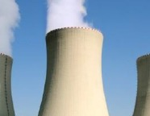
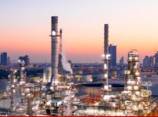

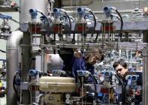
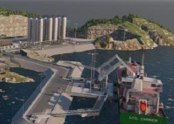
TUBACEX INDUSTRIES
01
02
03
04
05
06
Oil & Gas
Thermal & Nuclear
Downstream Process Industry
Aerospace
& Defense
Industrial
Low carbon
Global Upstream supplier
Market leader in critical applications: Umbilical and CRA OCTG Tubes
Present in the most demanding components
Benchmark for EDF / Full package solution
Delivering solutions to reduce OPEX
High Nickel components for the critical processes
Frame agreement contracts with main stakeholders
State of the art facilities meeting customer’s requirements
Market leader in High Nickel Alloy Heat-Exchangers
Added Value services and cost manufacturing improvements
Innovative solutions for main applications: CCS, H2
Joint Collaboration with research and technological centers
Covering the most demanding applications where corrosion, high temperatures and high-pressure resistance are key

Slide 10

BASIC OF STAINLESS STEEL

Slide 11
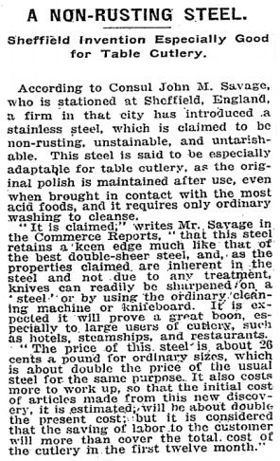
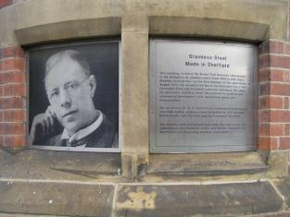
TECHNICAL CENTRE
History of Stainless Steel
1915, Sheffield, U.K.
Harry Brearley experimenting with alloy steels for gun barrels
Samples with 14% chromium were discarded as they proved to be unsuitable for this application
Some months later he noticed that low alloyed samples had rusted
The chromium alloyed samples were still bright
Announcement of Brearley's stainless steel discovery as it appeared in the 1915 New York Times.
Notes:
1913, Sheffield, U.K.
Harry Brearley experimenting with alloy steels for gun barrels
Samples with 14% chromium were discarded as they proved to be unsuitable for this application
Some months later he noticed that low alloyed samples had rusted
The chromium alloyed samples were still bright

Slide 12
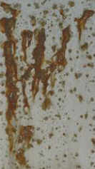



TECHNICAL CENTRE
Basic of Stainless Steel
12% Cr = full oxide cover
Stainless Steel is an Alloy with a minimum 12% Cr
1-2 atoms
thick
Corrosion
Rate
Stainless steel is an alloy
of iron and chromium
containing a minimum of
12% chromium.
Thin, tenacious, hard, tough, passive, corrosion resistant coating.
Re-passivates in the presence of oxygen when scratched, or damaged.
Used for:
Aesthetics
Hygiene
Longevity
Cryogenics
5%
10%
12%
Chromium Content
Notes:
1913, Sheffield, U.K.
Harry Brearley experimenting with alloy steels for gun barrels
Samples with 14% chromium were discarded as they proved to be unsuitable for this application
Some months later he noticed that low alloyed samples had rusted
The chromium alloyed samples were still bright

Slide 13
TECHNICAL CENTRE
Effects of Alloying Elements
Chromium:
    Most important alloying element
    The passive oxide layer is compound by Cr₂O₃,
    Quality and formation speed of passive layer depends on Cr content
Nickel:
    Has detrimental influence in the corrosion resistance
    But it is completely needed to hold an austenitic structure of the steel.
Molybdenum
Helps the formation of a strong passive layer,
But too high Mo content will lead to the formation of intermetallic phases, detrimental for the corrosion resistance.
Carbon, Sulphur and Phosphorus also help:
    Less will lead to lower impurity segregation, precipitations and therefore better corrosion behaviour.

Slide 14
CORROSION & MATERIAL SELECTION

Slide 15
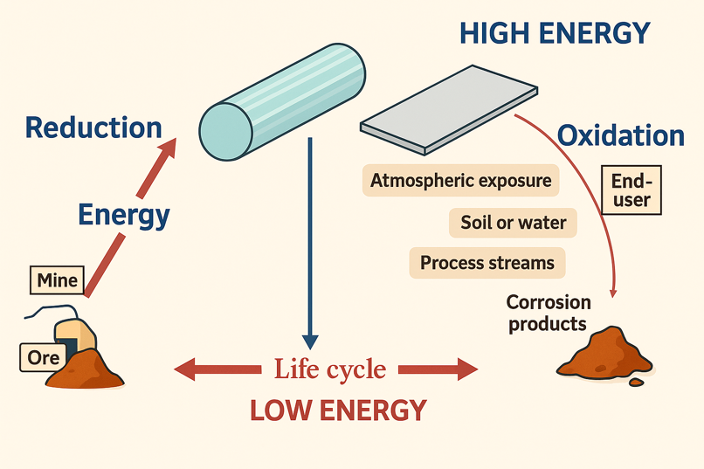
^{CORROSION: A NATURAL PROCESS}

Slide 16


^{MATERIAL SELECTION}
CORROSION
Nature of corrosion and extent of corrosion is main factor to decide the type of material to be used.
TYPES OF CORROSION
Various types of corrosion are Pitting, Crevice, Stress Corrosion, Inter Granular corrosion, Erosion general loss of materials.
COST VS LIFE
Also the cost of material vs life expected (Or criticality of exchanger) is also a deciding factor in material selection.
This is generally the mandate of Licensor or Engineering company but we can sometimes give suggestions around materials based on experience and data available (Not recommendations).
Notes:
Oil & Gas: After a strong recession in years 2020 and 2021, Oil & Gas investments will increase in the years to come driven by the necessity of securing an affordable energy supply. Positive cycle in the next 3 to 4 years expected, especially with investments in Gas, which is expected to play a crucial role in the ongoing energy transition. Oil & Gas companies have updated their CAPEX guidelines upwards. Great opportunities in specific locations as Brazil, Middle East or North Sea → Tubacex directs a significant portion of its high-value-added products towards this sector
Industry and Aerospace & defense: Traditional Linepipe business in difficulties due to macroeconomic situation and fierce competence. There are great opportunities for growth in H&I and Aerospace market that are growing at high speed
Low carbon & other energies: New opportunities arising in the market especially in Carbon Capture and Hydrogen. Recovery of nuclear market with huge expectations on newly developed SMR technology. Our ever-increasing involvement in projects linked to the energy transition is positioning us as a key player in global energy security and the quest for a sustainable energy mix.
Overall better market prospects despite macro uncertainties that could affect our forecasts.
Tubacex is ready to take advantage of its strong positioning in these sectors.

Slide 17
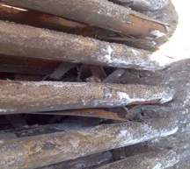

^{CORROSION TYPES}
Temperature < 300 - 400 Deg C
Temperature > 500 Deg C
WET CORROSION
HIGH TEMPERATURE CORROSION
1.
2.
3.
4.
Oxidation
Carburization
Sulphidation
Nitriding
Pitting Corrosion
Crevice Corrosion
Dew point Corrosion
Stress Corrosion Cracking
1.
2.
3.
4.

Slide 18

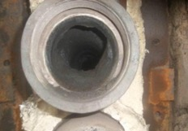
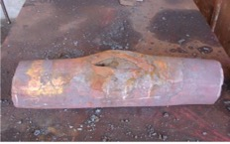
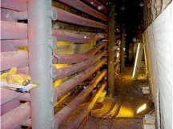
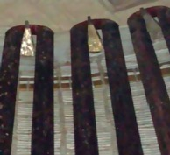
DEGRADATION MECHANISMS OF FURNACE TUBES
Several degradation mechanisms depending on the type of service, operating conditions, and the material of construction
Combination of multiple mechanisms: including carburization, oxidation, sulfidation, erosion, low toughness, and sigma phase formation
Sigma Phase (austenitic)
Tube impacted by CREEP
Tube with coke
Tube buckling
In some circumstances, heavily carburized tubes means better creep resistance

Slide 19
PROMOTION OF NAPHTENIC ACID ENVIRONMENT 316HNb
CURRENT TRENDS IN REFINERIES GLOBALLY
Corrosion Mechanisms:
Naphthenic Acid and Polythionic Acid
Feedstock
  Lower quality will be more widely used
    Higher Sulphur content
    Heavier fractions
    Higher TAN (total acid number)
Final products
  “Cleaner products”
    Lower Sulphur
Direct Effects on Tubes
Pitting corrosion , impingement and stress corrosion cracking
Intergranular Corrosion due to Chromium Carbides, aggressive during shutdown
Material Recommendation as per corrosion experts
Enhanced creep rupture strength and tube life
Resistant to sensitization up to 650°C
Resistant to polythionic acid intergranular corrosion and eliminates need for soda ash wash
Resistant to naphthenic acid attack
Readily weldable using conventional processes
Thin wall allows for optimum heat transfer and reduction of thermal stress
Stainless Steel with higher molybdenum (above 2.5%)
Stainless Steel with stabilizing element (Ti or Nb)
TX 316HNb

Slide 20
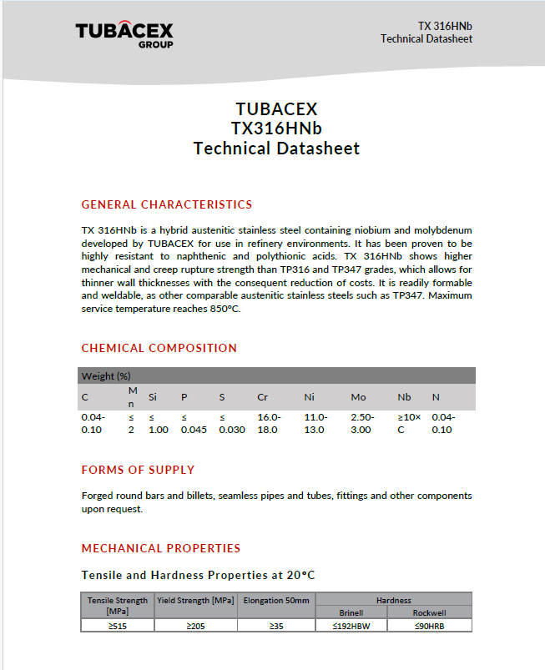
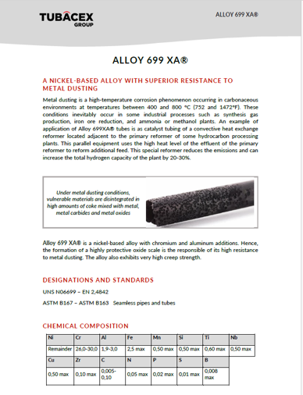
MATERIAL DATA SHEETS (MDS) AVAILABLE)

Slide 21
WIDE RANGE OF ALLOYS
GRADES
SR. NO
UNS
EN
COMMON NAME
GRADES
SR. NO
UNS
EN
COMMON NAME
AUSTENITIC
1
S30403, S30400
1.4306, 1.4301, 1.4307
304L
SUPER
AUSTENITIC
1
S31254
1.4547
6 Moly
2
S30409
1.4301
304H
2
N08926
1.4529
Alloy 926
3
S31603, S31600
1.4401, 1.4404
316L
3
N08367
08367
4
S31603, S31600
1.4435, 1.4436
316L High Moly,.
4
S30600
1.4361
High Si Steel.
5
S31653, S31653
1.4910
316LN
5
N08904
1.4539
904L
6
S31700
1.4438
317L
HIGH NICKEL BASED MATERIALS
6
N08020
Alloy 20
7
S31725, S31726
1.4439
317LM / LMN
7
N08028
1.4563
Alloy 28
8
S31635
1.4571
316Ti
8
N06059
2.4605
Alloy 59
9
S32100 / S32109
1.4541 / 1.4878
321 / 321 H
9
N02201,N02200
2.4068, 2.4066
Ni 200 and Ni 201
10
S31002
1.4335
25-21/310LNAG
10
N04400
2.4360
Alloy 400
11
S32109, S34700
1.4550
347 / 347H
11
N06600
2.4817
Alloy 600
12
S30908, S30909
1.4833
309S
12
N06601
2.4851
Alloy 601
13
309S
1.4845
310 / 310 S
13
N06625
2.4856
Alloy 625
14
S30815
1.4835
253MA
14
N06690
2.4642
Alloy 690
DUPLEX
15
S32304
1.4362
UNS 32304
15
N08800,N08810,N08811
1.4876, 1.4958, 1.4959
Alloy 800, 800H and 800HT
16
S31500
1.4424
UNS 31500
16
N08825
2.4858
Alloy 825
17
S31803, S32205
1.4462
31803
17
N01276
2.4819
C-276
18
S32750
1.4410
32750
18
N06022
2.4602
C-22
19
S32760
1.4501
32760
19
N06699
2.4842
VDM® Alloy 699XA
20
S32906
1.4477
32906
SPECIAL MATERIALS- UREMIUM 29, SATURN 31, ALLOY 617, SPECIAL METALS ALLOY 740H, HAYNES 230, HYTBX, BI METALS

Slide 22
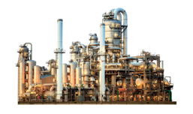
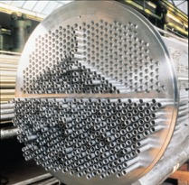
KEY CHALLENGES IN PETROCHEMICAL AND SPECIALITY CHEMICAL ENVIRONMENTS
SEVERE CORROSIVE CONDITIONS 🧪
Growing exposure to chlorides, hydrogen sulphides (H₂S), and aggressive acids is accelerating material degradation, especially in critical process equipment.
VARIABLE & LOWER-QUALITY FEEDSTOCKS ⚙️
Increased processing of sour and unconventional crude introduces complexity in operations and heightens corrosion and fouling risks.
HIGH-TEMPERATURE OPERATIONS 🔥
Sustained exposure to elevated temperatures imposes significant thermal stress, demanding materials with exceptional heat resistance and stability.
TIGHTENING SAFETY & ENVIRONMENTAL STANDARDS 🌍
Stricter global compliance norms require cleaner operations, lower emissions, and more robust safety measures across the value chain.
FOCUS ON OPERATIONAL EFFICIENCY & COST CONTROL 📉
Minimizing downtime, extending asset life, and reducing maintenance spend are critical priorities amidst rising competitive pressure.
MATERIAL SELECTION & COMPATIBILITY CHALLENGES 🏗️
Identifying alloys that balance corrosion resistance, mechanical strength, and cost-efficiency remains a technical and strategic challenge.
Aggressive service conditions in the Petrochemical & Speciality Chemical Industry is driving need for Special Alloys

Slide 23
^{APPLICATIONS, NICKEL ALLOYS}
 | MAIN CORROSION PROPERTIES | INDUSTRIES
ALLOY 20 | Resistance to sulfuric and phosphoric. Good resistance to chloride stress corrosion cracking. | Sulfuric acid (Coolers), Phosphoric acid (Heaters).
ALLOY 28 | Resistance to strong acids. Good Pitting and Crevice corrosion resistance. | Sulfuric acid (Coolers), Phosphoric acid (Heaters), Refinery (sea coolers, Naptha Vaporiser)
ALLOY 59 | Resistance to Sulfur /salt acid mixtures as well as to oxidizing, reducing and Mineral acids. Good chloride stress and pitting corrosion resistance. | HF acid reactors, Refinery (Over head condensers), Flue gas condensers, Acetic and Formic acid condensers
ALLOY 400 | Excellent resistance to hydrofluoric acid, Reducing media and Marine conditions | Refinery (HF Alkylation condenser), Chlor-Alkalis, tubes in O&G platforms.
ALLOY 600 | Resistance to heat and wet corrosion. Oxidation resistance at high temperatures. Immune to chloride ion stress corrosion resistance. Resistance to high temperature nitriding environment. | HF acid reactors, Flor Alkalis, Chlor-Alkali, Gas Reformers. Nuclear Industry steam generators.
ALLOY 601 | Resistance to heat and wet corrosion. Oxidation and carburization resistance. Metal dusting corrosion resistance. | Ammonia / Methanol Plants (Waster heat recovery boilers), Steam reforming
ALLOY 617 | Resistance to oxidizing & Reducing acids. Oxidation resistance at High Temperatures | Gas Turbines tubes
ALLOY 625 | Types A / B for wet corrosion and high temperature corrosion resistance. Good resistance to strong acids , salts chlorides and sulphides. | Refinery (Over head condensers), Petrochemical and chemical industries dealing with acids and salts. O&G platforms and processing units (condenser-coolers).
25.21/ UNS S31002 | Good resistance to Nitric acid corrosion up to 65% | Nitric acid cooler, condensers, tail gas pre heaters,

Slide 24
^{APPLICATIONS, NICKEL ALLOYS}
 | Main CORROSION PROPERTIES | INDUSTRIES
ALLOY 690 | High temperature corrosion resistance manly Metal dusting/ carburization corrosion resistance. | Ammonia / Methanol Plants (Waster heat recovery boilers), Steam reforming, Steam generators in Nuclear industry
ALLOY 699XA | Excellent resistance to Metal dusting corrosion. Al + Cr provides stable passive layer. | Ammonia / Methanol Plants (Waster heat recovery boilers), Hydrogen reformers
ALLOY 800H, 800HT | Excellent creep properties at high temperatures. Good resistance to normal and cyclical oxidizing and carburizing environments. | Pig tails in Ammonia Plants, Muffle tubes, Reformers.
ALLOY 825 | Resistance to Localized corrosion. sulphides and Salts. Resistance to chloride stress corrosion cracking. | Refinery (React effluent / Feed effluent air coolers)
ALLOY 926 | High resistance to chloride induced pitting, crevice and stress corrosion mainly due to high Chrome and Moly. | Salt vaporisers, Flue gas condensers, Sea water coolers.
NICKEL 200,201 | Excellent resistance to caustic environments. | Caustic Evaporators, Phosgene Reactors
C-276 | Excellent sulphide stress corrosion cracking resistance besides resistance to Organic and string acids. | Flue gas condenser, Gas condensation units, Sour service in O&G industry. Heat exchangers for organic acids such as fatty acids
C-22 | Resistance to high temperature attacks by chlorides, halides. High temperature resistance to sulfidation and oxidation. | HF and HCL acids heaters, Reactors.
253MA | Good resistance to cyclic oxidation. Presence of Ce helps in forming strong passive layer. | Carbon black (Air pre heaters), Steel plant rolling mills (Recuperators)

Slide 25
PETROCHEMICALS/SPECIALITY CHEMICALS/ACID – FREQUENT GRADES
PLANT | APPLICATION/PRODUCTS | MATERIALS
METHANOL | Methanol reactor, Waste heat recovery boiler, Re Boiler | 31500, Alloy 601, Alloy 690, Alloy 699XA
PTA | Condensers, Slurry Heaters | 31803/32205, 317L, 904L
EDC/VCM | Crackers, Condensers | Alloy 600, Alloy 800HT, 31803, Alloy 400, Nickel 201, C-276
CAUSTIC | Evaporators | Nickel 201/ 2906
HCL | Reactors, Condensers | Alloy625, C-276, Nickel 201, Alloy 400
HF | Furnace , Condenser | Alloy 600, Alloy 625, C-276, Alloy 400
EO/PO REACTORS | Reactor | 31803/32205
KETANE | Furnace | 253MA
ACETIC | Heater / Condenser / Cooler | Alloy 28, 904L, 32750, 31803
FORMIC | Condenser | Alloy 59
MDI/TDI | Phosgene reactor, Cooler, | Nickel 201, Alloy 400, Alloy 625, C-276
FATTY ACIDS | Coolers | 904L / 317L / C-276

Slide 26

TUBACEX PRODUCT PORTFOLIO FOR HEAT EXCHANGER APPLICATIONS

Slide 27


GLOBAL PRODUCTION FOOTPRINT - HEAT EXCHANGER TUBES
Tubacex Group's heat exchanger tube program is based on manufacturing units at these 5 strategic locations
01
02
03
04
05
06
Ternitz, Austria
Umbergaon, India
Greenville, U.S.A
Durant, U.S.A
TTI, Spain
Wide range of grades. Specializes in Special grades. Long lengths.
All standard grades, duplex, super duplex & Nickel Alloys Straight and U bends, wide approvals.
Quick deliveries for turn around jobs, wide range of grades.
Latest in Tubacex family. Quick deliveries. Growing references.
Specializes in big sizes 1 to 3 inch. Big range of approvals .
Wide range of Grades , Sizes and Deliveries to meet any need of customer

Slide 28
GLOBAL FOOTPRINT
01
02
03
04
05
06

Slide 29
WIDE RANGE OF ALLOYS – HEAT EXCHANGER APPLICATIONS
GRADES
SR. NO
UNS
EN
COMMON NAME
SBER AUSTRIA
TTI
SPAIN
SALEM
USA
DURANT
USA
TTP
INDIA
AUSTENITIC
1
S30403, S30400
1.4306, 1.4301, 1.4307
304L
2
S30409
1.4301
304H
3
S31603, S31600
1.4401, 1.4404
316L.
.
.
.
.
.
4
S31603, S31600
1.4435, 1.4436
316L High Moly,.
5
S31653, S31653
1.4910
316LN
6
S31700
1.4438
317L
7
S31725, S31726
1.4439
317LM / LMN
8
S31635
1.4571
316Ti
9
S32100 / S32109
1.4541 / 1.4878
321 / 321 H
10
S31002
1.4335
25-21
11
S32109, S34700
1.4550
347 / 347H
12
S30908, S30909
1.4833
309S
13
309S
1.4845
310 / 310 S
14
S30815
1.4835
253MA
DUPLEX
15
S32304
1.4362
UNS 32304
16
S31500
1.4424
UNS 31500
17
S31803, S32205
1.4462
31803
18
S32750
1.4410
32750
19
S32760
1.4501
32760
20
S32906
1.4477
32906

Slide 30
WIDE RANGE OF ALLOYS (SPECIALS & HIGH NICKEL)
GRADES
SR. NO
UNS
EN
COMMON NAME
SBER AUSTRIA
TTI
SPAIN
SALEM
USA
DURANT
USA
TTP
INDIA
SUPER
AUSTENITIC
1
S31254
1.4547
6 Moly
2
N08926
1.4529
Alloy 926
3
N08367
08367
.
4
S30600
1.4361
High Si Steel.
5
N08904
1.4539
904L
HIGH NICKEL BASED MATERIALS
6
N08020
Alloy 20
7
N08028
1.4563
Alloy 28
8
N06059
2.4605
Alloy 59
9
N02201,N02200
2.4068, 2.4066
Ni 200 and Ni 201
10
N04400
2.4360
Alloy 400
11
N06600
2.4817
Alloy 600
12
N06601
2.4851
Alloy 601
13
N06625
2.4856
Alloy 625
14
N06690
2.4642
Alloy 690
15
N08800,N08810,N08811
1.4876, 1.4958, 1.4959
Alloy 800, 800H and 800HT
16
N08825
2.4858
Alloy 825
17
N01276
2.4819
C-276
18
N06022
2.4602
C-22
19
N06699
2.4842
VDM® Alloy 699XA
08367 / 08926 Dual certified. 2) Please refer to current size range capabilities on SBER shared earlier. For other Mill please check with plants. Generally WT/OD > 0.05 should be possible to be produced 3) Red marked star indicates, under trials, approval (not being offered yet). 4) Mill may / may not offer based on availability of raw material. 5) MOQ required is different for each Mill.

Slide 31

TUBACEX TUBES & PIPES PVT. LTD (TTP) INDIA

Slide 32
TUBACEX TUBES & PIPES PVT LTD (TTP) HISTORY
Duplex ,Super-Duplex grade Pipe Tube Production
API approval for (American Petroleum Institute)
AS 9100 Approval
EIL Enlistment
(Ni Alloys)
UDT Approval
Umbergaon Facility Production Roll out
TTP 100% Subsidiary of Tubacex SA
Saudi Aramco Approval
ONGC Approval
PDO Approved
Cairns Energy, RIL J3
2006
2009
2010
2011
2012
2013
2014
2015
2021
2023
2024
2025
2026
Hot Piercing mill Production commences for making Seamless Mother Hollows
KNPC Approved
SASOL Approved, Takreer approved
SABIC, Flour, APGENCO Approved
Acquisition of 68% of seamless stainless steel tubes division by TUBACEX Group
NABL Accreditation as per ISO 17025:2017
ARAI Product Approval as per IS IS 15716:2006, Supply to ISRO for Ganganyan program,

Slide 33






INTRODUCTION
TUBACEX Tubes & Pipes Pvt. Ltd. (TTP)
S. KOREA
CHINA
48 M
SALES – FY 23
12 M
INVESTMENT
SINCE ACQUISITION
100%
ACQUISITION ON
31 Mar 2021
UAE
TSS
MIDDLE EAST
1
PRODUCTION FACILITY IN GUJARAT
>120
CUSTOMERS
TSS INDIA
WIDEST PORTFOLIO IN TERMS OF SIZES, GRADES & LENGTH
INDIA
TUBACEX
AWAJI
THAILAND
TTP
MALAYSIA
ATTENDING TO MOST DEMANDING MARKETS
52414 m²
TOTAL FACILITY AREA
8000 T
PRODUCTION OF TUBES & PIPES
SINGAPORE
SALES OFFICE
WAREHOUSE
MANUFACTURE

Slide 34
MAJOR INVESTMENTS, PRODUCT/ GRADE DEVELOPMENT & LOCALIZATION JOURNEY
INVESTMENT IN MEUROS
SMS 75 Pilgers
SAF Upgrade
which were producing HX Tubing in TTI, Spain
347 / 347 H Grade Qualified for Boiler Tubing
Duplex
904L
UNS 31254
Super Duplex
Alloy 825
Alloy 625
Alloy 800/H
UNS 30432
Hastelloy
C-276
Alloy 600
Alloy 601
Monel 400
Alloy 200/201
Hastelloy C -22
253 MA

Slide 35
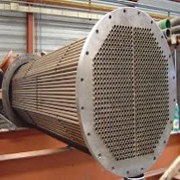
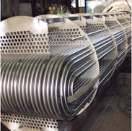
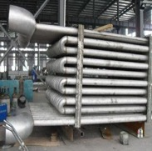
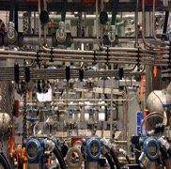
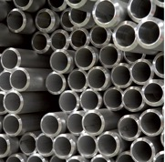
PRODUCT CAPABILITY – Tubacex Tubes and Pipes Pvt. Ltd (TTP)
Heat Exchanger Straight Tube
Boiler & Fired Heaters
Instrumentation Tube
Line Pipe
Heat Exchanger U/C Tube
01
02
03
04
05
CAPABILITY
CAPABILITY
CAPABILITY
CAPABILITY
CAPABILITY
In mm | MIN | MAX
OD | 12.70 | 76.10
WT | 1.24 | 6.00
LENGTH M | 2.00 | 30.00
In mm | MIN | MAX
OD | 12.70 | 38.10
WT | 1.24 | 3.40
LEG LENGTH M | 1.50 | 10.00
RADIUS | 1.5D | 1.25M
STRESS RELIEVING | U bend + 300 mm both legs
In mm | MIN | MAX
OD | 21.34 | 114.3
WT | 2.77 | 11.13
LENGTH M | 2.00 | 12.00
In mm | MIN | MAX
OD | 6.00 | 76.10
WT | 0.89 | 6.00
LENGTH M | FIXED LENGTH OF 6M
In mm | MIN | MAX
OD | 9.52 | 114.3
WT | 1.24 | 8.56
LENGTH M | SRL/ DRL / FIXED
GRADES
304L, 304H, 316L, 321, 321H 316Ti, 317L, 347, 347LN*,Lean Duplex, Duplex, Super Duplex,904L, 6Mo, 825, 800/H, 600, 601,M400, 625, C-276, C-22,Alloy 200/201
GRADES
304H, 316H,321H. 310S, 347H, S30432 (Super 304), A740, TX25, 253MA
GRADES
304L/H, 316L, 321, 321H 316Ti, TP347/H
Duplex (UNS S30813/S32205) Upto 3” OD
Nickel Alloys Upto 1 1/2” Sch 80 (A600/601/M400/C276/C22)
GRADES
304L, 316L, 316L (2.5%Mo), 321, 321H, 316Ti
6Mo, 625, C-276, M400
GRADES
304L, 304H, 316L, 321, 321H 316Ti, 317L, 347, 347LN, Lean Duplex, Duplex, Super Duplex, 904L, 6Mo, 825, 625, 800/H, 600, 601, M400, 625, C-276, C-22, Alloy 200/201
SPECIFICATION
ASTM A 312 / ASME SA 312
ASTM A 213 / ASME SA 213
ASTM A 376 / ASME SA 376
SPECIFICATION
ASTM A 213 / ASME SA 213
ASTM A 789 / ASME SA 789
ASTM B 163 / ASME SB 163
ASTM A 376 / ASME SA 376
EN 10216-5 , A / SA 269, DIN 23789
* >14m BA route upto 38mm OD
SPECIFICATION
ASTM A 213 / ASME SA 213
ASTM A 789 / ASME SA 789
ASTM A 269 / ASME SA 269
EN 10216-5
SPECIFICATION
ASTM A 312 / ASME SA 312
ASTM A 790 / ASME SA 790
ASTM B 165 / ASME SB 165
EN 10216-5
SPECIFICATION
ASTM A 213 / ASME SA 213
ASTM A 789 / ASME SA 789
ASTM B 163 / ASME SB 163
ASTM A 376 / ASME SA 376
EN 10216-5, A / SA 269, DIN 23789
Surface Finish
BA or BA+Polish
SA, Pickle Passivated
SA, Pickle Passivated +Polish upto OD 38.1mm
Notes:
The Group has the widest portfolio of tubular solutions. We produce and sell seamless stainless steel and high nickel alloy tubes used in countless applications.. Our seamless stainless steel tubes are specially designed to be used in industrial processes where high temperature, pressure and corrosion conditions take place.
In addition to its manufacturing capabilities, TUBACEX brings a different value proposition to the market and offers a series of high added value operations and services to complete its global offer.
We seek customer satisfaction through a portfolio of products and services that are constantly being developed.

Slide 36
TUBACEX SPECIAL METALS COLLABORATION

Slide 37
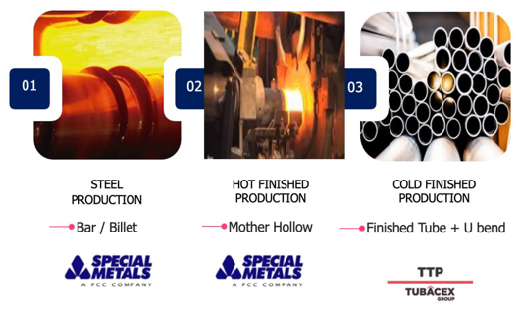
TUBACEX SPECIAL METALS COLLABORATION
Long-standing global collaboration between Tubacex and Special Metals in the aerospace sector, with supplies through Tubacex plants in the USA (Mother Hollows supplying to Tubacex Salem, USA)
Successful localization of Alloy 740H (patented by Special Metals) at TTP, supporting next-generation AUSC boiler technology for BHEL and NTPC.
Heat Exchanger Tubing – Collaboration Scope (India)
  Grades: Alloy 600, Alloy 601, Alloy C-276, Alloy C-22, Monel 400, Alloy 200/201
  Sizes up to 2” OD: Tubacex to lead customer discussions with support from the Special Metals India team.
  Sizes above 2” OD: Tubacex and Special Metals to evaluate jointly on a case-by-case basis, considering value proposition and customer requirements.
Business Development Initiative
  Plan to conduct joint technical seminars for end users and fabricators.
TTP MANUFACTURING ROUTE FOR HIGH NICKEL ALLOY TUBES (A600,A601,M400,C-276, C-22, Ni200/201)

Slide 38
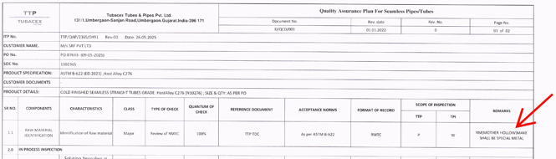
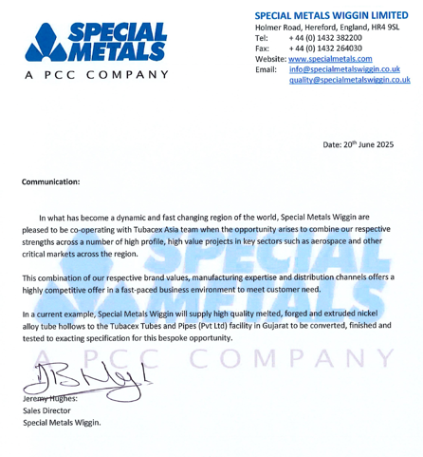
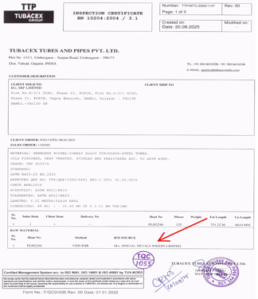
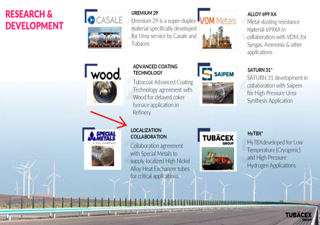
COMMUNICATION TO END USERS & FABRICATORS
ITP & MTC including Special Metals name as Raw material to establish traceability
Some Examples

Slide 39

ADVANCED ALLOY SOLUTIONS FOR NEXT-GENERATION PETROCHEMICAL & SPECIALTY CHEMICAL APPLICATIONS
  Alloy 699XA
  Alloy 602MCA
  Alloy 31 Plus
  Alloy 59

Slide 40
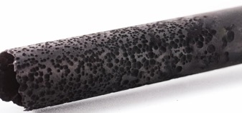
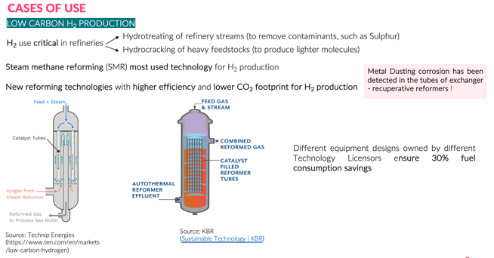
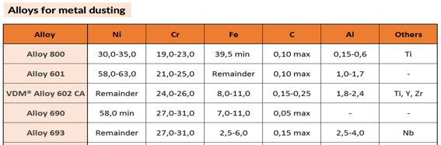
METAL DUSTING CORROSION PHENOMENON
Environment: gas phase, potentially carburizing and reducing with or without oxygen, i.e., mixtures of CO, H₂, H₂O and CO₂
Temperature: 400-800°C
Form of attack: pitting and/or general overall surface consumption via carburization
Susceptible alloys: iron, nickel or cobalt base alloys
Product: powder composed of graphite mixed with metal, metal carbides and metal oxides (“metal dust”)
Affected industries: Syngas process in hydrogen, ammonia, methanol, e-fuel production & gas to liquid plants
A tube severely corroded by Metal Dusting

Slide 41
ALLOY 699 XA® TUBES
CHEMICAL COMPOSITION
Alloy 699 XA® development targets:
High metal dusting resistance
(higher than Alloy 602 CA)
High creep resistance
(at least like Alloy 601)
Good workability
(higher than Alloy 602 CA)
Good weldability
Alloy 699 XA® has high Cr and Al content and low Fe content
Alloy | Ni % | Cr % | Fe % | Mn % | Si % | Al % | Ti % | C % | Others
600 | 72 | 16 | 8 | 0,3 | 0,3 | 0,3 | 0,3 | 0,08
601 | 60,5 | 23 | 13 | 0,2 | 0,2 | 1,4 | 0,4 | 0,05
602 CA | 62 | 25 | 9 |  |  | 2 |  | 0,18 | Y, Zr
690 | 59 | 29 | 9 | 0,2 | 0,1 | 0,3 | 0,3 | 0,02
693 | 62 | 29 | 4 |  |  | 3 |  | 0,02 | Nb, Zr
Alloy 699 XA ® | Balance | 30 | Max, 2,5 |  |  | 2 |  | 0,02 | Nb, Zr
Granted Alloy Numbers: 2.4842 / UNS N06699
Alloy 699 XA® tubes of several dimensions have been successfully produced (OD × WT in mm): 159,00 × 20,00 - 114,3 × 6,02 - 88,9 × 3,06 - 60,32 × 3,92 - 73,00 × 3,00 - 44,50 × 6,30 - 33,4 × 2,89 - 25,40 × 2,40.

Slide 42
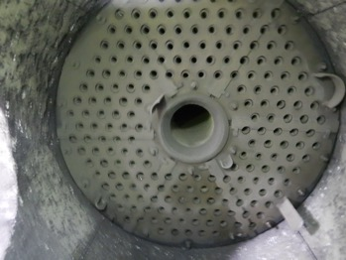
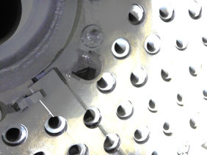
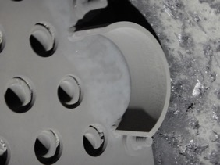
PRACTICAL PERFORMANCE UNDER METAL DUSTING CONDITIONS
Hydrogen Production Unit Reformer
EUROPEAN REFINERY
Context:
Evaluation of Alloy 699XA (N06699) installed in refinery hydrogen reformer.
Exposure: 36,000+ hours (Feb 2021 – Apr 2025).
Results:
Visual inspection confirms no metal dusting corrosion.
Superior performance compared to benchmark alloy.
Next Steps:
Continued monitoring; next inspection in 2027.
Alloy 699XA samples
Superior metal dusting resistance of Alloy 699 XA® tubes: Images clearly demonstrate Alloy 699XA's outstanding resistance to metal dusting corrosion, highlighting the integrity of the alloy surface after prolonged exposure in severe reformer conditions.

Slide 43
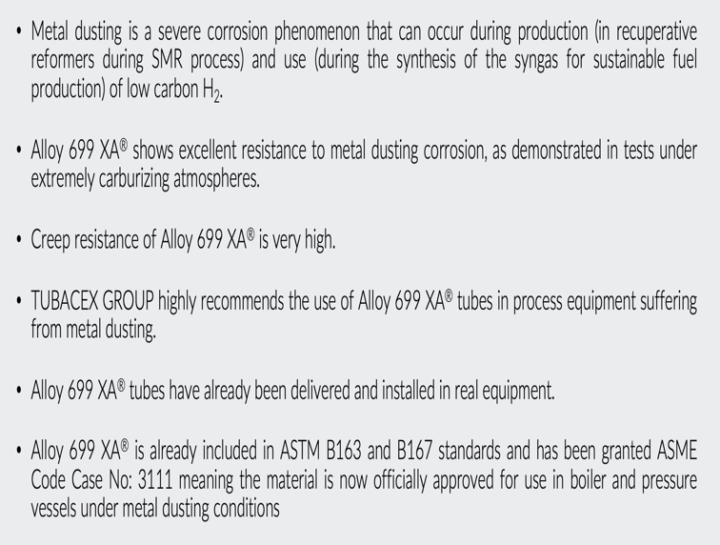
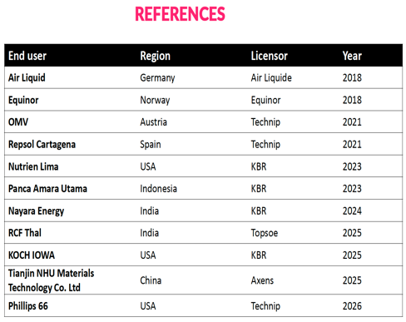
SUMMARY & SUPPLY REFERENCES

Slide 44
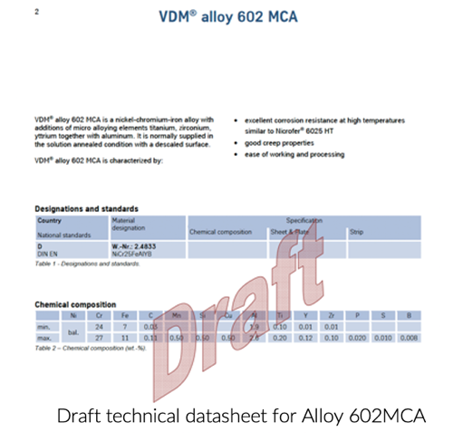
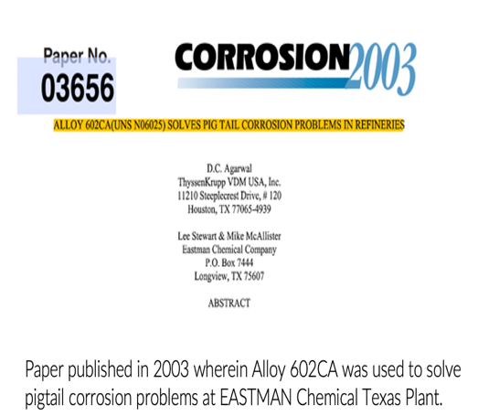
TUBACEX - VDM NEW DEVELOPMENTS
Alloy 602MCA
  This is one more joint development that we are current doing along with VDM Metals Germany after being successful with Alloy 699XA.
  Alloy 602MCA should help us to position it wherever Alloy 602CA was being used. Alloy 602CA was only available in welded tube/pipe form which limited its use in majority of the high temperature application

Slide 45

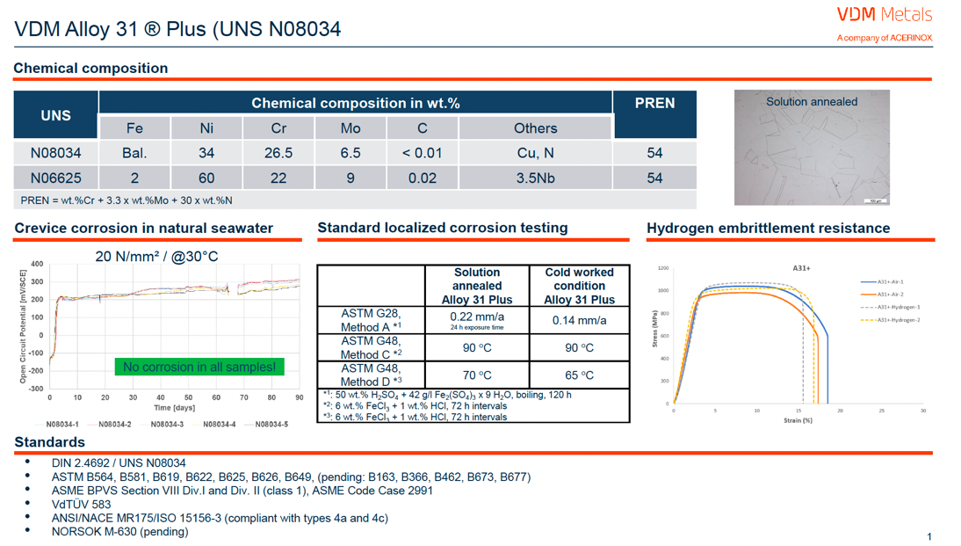
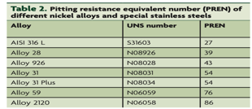
ALLOY 31 PLUS

Slide 46
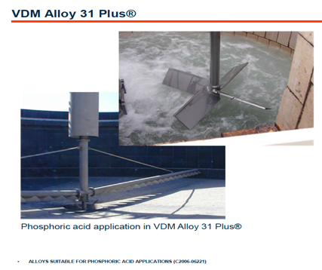


ALLOY 31 PLUS
ACID Resistance

Slide 47
ALLOY 59 – INTRODUCTION
Alloy 59 for Severe Corrosive Heat Exchanger Applications
Industry Need
Heat exchanger tubing in aggressive environments requires materials with high resistance to:
  Acids & salts
  High temperatures
  Chloride corrosion
Commonly Used Alloys
Hastelloy® C-276
Hastelloy® C-22
Alloy 59 – emerging preferred solution
Why Alloy 59?
Excellent corrosion resistance in oxidizing & reducing media
Superior resistance to:
  Chloride pitting
  Crevice corrosion
  Stress corrosion cracking
Key Applications
Fertilizer Industry – Melamine process
Power Generation – Flue Gas Desulfurization (FGD)
Petrochemical & Specialty Chemicals
  Heaters
  Coolers
  Condensers
Typical Process Media
  Formic Acid
  Acetic Acid
  Hydrochloric Acid
  Sulfuric Acid
Alloy 59 has been gaining popularity for severe corrosive environments under oxidizing and reducing conditions

Slide 48
ALLOY 59 – CHEMICAL COMPOSITION
Description-
Alloy 59, approved both with European and ASTM, Designations- 2.4605 / NiCr23Mo16Al, N 06059 , Standard ASTM B 622
Chemical composition (key elements)
 | C Max | Cr | Ni | Mo | Co | Al | Others
N 06059 | 0.01 | 22-24 | 56-63 | 15-16.5 | <0.3 | 0.1-0.4 | Si < 0.1
N 10276 | 0.01 | 15-16.5 | 51-59 | 15-17 | <2.5 |  | W < 4.5
N 06022 | 0.015 | 20-22 | 51-60 | 12.5-14.5 | <2.5 |  | W 2.5-3.5
Critical alloying elements
Extremely low Carbon & Silicon means no tendancy for grain boundry corrosión.
High % of chromium, Molybdenum and Nickel leads to good resistance to chlorides.
Higher Moly in Alloy 59 compensates for absence of Tungsten as in N10276/N06022 leading to better thermal stability.

Slide 49


ALLOY 59
Pitting Resistance Equivalent Number (PREN)
Mechanical Properties
N06059 75-77
N10276 68-70
N06022 64-66
Alloy 31 52-54
Alloy 625 51-52
* Using Cr + 3.3 Mo + 30 N
Higher yield strength of Alloy 59 vs N10276/N06022 allows for use a smaller wall thickness in seamless tubular applications allowing for reduction in cost and weight.
Alloy 59 has higher PREN and higher yield strength as compared to C-276 and C-22

Slide 50
ALLOY 59 – CORROSION PROPERTIES
G28 Method A (resistance to intergranular corrosion). Ferric sulphate and sulphuric acid boiling test
50% H₂SO₄ + 42g/litre Fe₂ (SO₄)₃
Thermal Stability properties can be measured by completing the ASTM G28A & G28B tests after sensitizing the material at 871°C.
Media | C276 | 22 | 59
ASTM G28A | >500 | >500 | 40
ASTM G28B | >500 | 339 | 4
Pitting attack | severe | severe | none
Intergranular attack | severe | severe | none
Corrosion rate (mpy)
Alloy C276, 22 Heavy pitting attack due to intergranular attack.
Alloy 59: No attack.

Slide 51
CONCLUSION
Enabling Reliability in the Most Demanding Corrosive Environments
Petrochemical and specialty chemical industries are facing increasingly aggressive process conditions, higher temperatures, and stricter reliability requirements.
Advanced high-nickel alloys are becoming critical for maximizing plant uptime, improving safety, and reducing lifecycle costs.
Tubacex offers a complete portfolio of seamless tubular solutions engineered for severe corrosion and high-temperature applications.
Joint developments with global technology leaders — including Alloy 699XA®, Alloy 59, Alloy 31 Plus, Uremium® 29, and SATURN® 31 — demonstrate Tubacex’s commitment to innovation and application-focused metallurgy.
With localized manufacturing capabilities in India and strong global partnerships, Tubacex is uniquely positioned to support the growing needs of the petrochemical and specialty chemical sectors.
The right alloy selection is no longer just a material choice — it is a strategic decision impacting plant reliability, sustainability, safety, and long-term operational efficiency.

Slide 52




TUBACEX TEAM – SHARING YOUR CHALLENGE
CONTACT US in suggesting proper weld consumables.
Name: Deepak Bhardwaj
Email: dbhardwaj@tubacex.com
Telephone: :+91 9867770967
Regional Sales Head – West & Central India Based in Mumbai, India
Name: Swagat Rajguru
Email: srajguru@tubacex.com
Telephone: :+91 9099095065
Business Development Manager – HX and H&I India Based in Mumbai,India
Name: Shabareesh Nair
Email: snair@tubacex.com
Telephone:+91 9545336917
Director – Technical Marketing Asia & Middleeast Process Industry Solutions Manager – Asia & Middleeast
Based in Pune, India
Name: PV Anand
Email: pvanand@tubacex.com
Telephone:+91 7069268533
Sales & Marketing and Commerical Director India
Based in Mumbai, India

Slide 53

Parque Científico y Tecnológico de Bizkaia, Idiazabal Bidea,
Edificio 702, 1ª planta 48160 Derio (Bizkaia)
+34 722 444 155 · sales@tubacex,com
www,tubacex,com

